Slide 1
Project Name :- TO -DO -TRACKER
Presented By :-
Team-8
Rohit Kumar Soni,
Kashinath Nadar,
Praveen M.
Mentor :-
Anjali Singhal.

Slide 2
ABOUT TEAM :- together ,we are learning and trying to achieve
our goals . Though the primary purpose of this
group is to discuss about the to-do-tracker project and implement them in our PROJECT . We are also improving our skills and developing our articulations.
PHOTOGRAPH WITH NAME :-

Slide 3
ABOUT THE PROJECT :-
A TO-DO-TRACKER is a simple list of tasks that allows you to visually see what you need to accomplish .
Its all in ONE place for EASY reference !
Grows and Shortens as YOU work through items.
It’s a ORGANIZATIONAL scheduling tool.
Can be a “NOT-TO-DO” List Tracker also.

Slide 4
WHY?
Reduce stress by prioritizing tasks .
Remind yourself of what’s important and what needs to get done first .
It can be fun !!
- Playing with the tracker can help you think outside of the box for different solutions.

Slide 5
ARCHITECTURE :-

Slide 6
TOOLS AND TECHNOLOGIES :-
IntelliJ IDE .
Visual Studio Code .
MySQL .
MongoDb .
Front End – Angular .
Back End – To-Do-Eureka , To-Do-Gateway ,To-Do-Authentication , To-Do- Service , To-Do-Archieve-Service ,Notification.

Slide 7
FRONT END :-
Angular :- Angular is a platform and framework for building single-page client applications using HTML and TypeScript. Angular is written in TypeScript. It implements core and optional functionality as a set of TypeScript libraries that you import into your applications .
The components that are used to support our application are :-
- About-app ,Add-task ,Archieve-list ,Change-password ,Dash-board ,Detailed-list ,Features ,Home-page ,Login ,Notification ,Page-Not-Found ,Recycle-bin ,Sign-up, Task-list ,Update-profile and Update-task .
The model that are used to support our application are :-
- Task and list.
The services that are used to support our application are :-
- Api.service ,notification.service ,ro-do-service ,urls-service and ro-do-guard.

Slide 8
Back End :-
To-do-eureka :- to-do-eureka service is used to register and update the port number all the services.
To-do-gateway :- to-do-gateway service is a entry point for the user request to an api .
To-do-service :- to-do-service is used for updating profile after login, Adding task ,(updating )task , heading , start date , end date , priority ,delete , remove ,deleted task ,all task ,all-pending task , (sorting ) using start date ,priority ,end-date ,get-task.
To-do-authentication :- to-do-authentication service is used for registering new user , login & update the user details in it.

Slide 9
To-do-archieve :- to-do-archieve service is used for registering user in archieve ,updating profile ,adding task ,getting- completed tasks ,getting-deleted tasks , deleting and removing task .

Slide 10
DEMO OF THE PROJECT

Slide 11
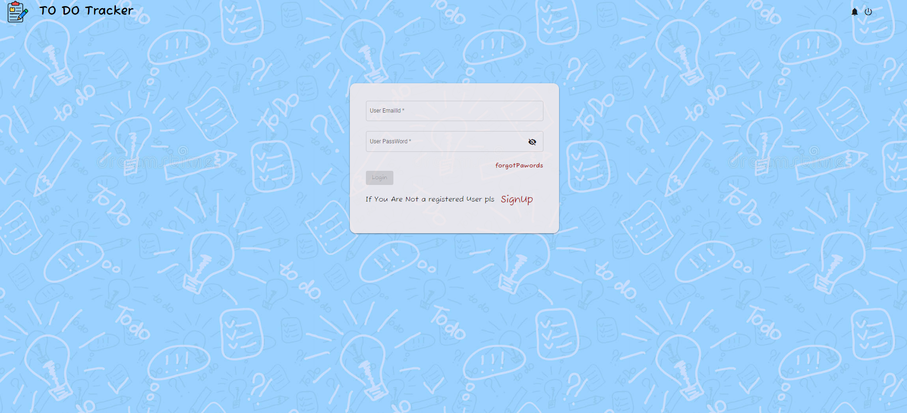
LOG-IN & SIGN-UP
IT’S THE LOGIN PAGE OF THE TO-DO-TRACKER APP .
FROM HERE WE CAN LOGIN TO OUR APPLICATION.
IF YOU ARE A NEW USER YOU CAN CREATE A NEW ACCOUNT BY CLICKING ON THE SIGN-UP OPTION .

Slide 12
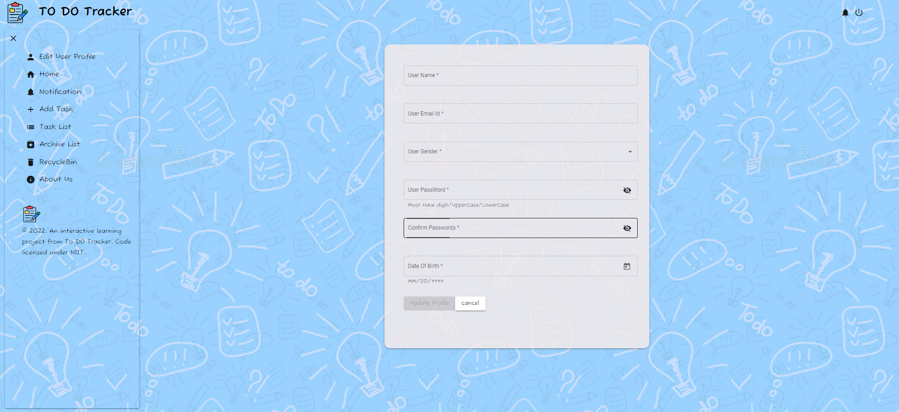
EDIT USER PROFILE
IN THE EDIT USER PROFILE WE CAN UPDATE YOUR LOGIN DETAILS.
WE CAN EASILY UPDATE THE NAME , EMAIL , GENDER , PASSWORD & DATE OF BIRTH.
AFTER UDPATION OF OUR DETAILS , WE HAVE TO LOG IN ONCE AGAIN.

Slide 13
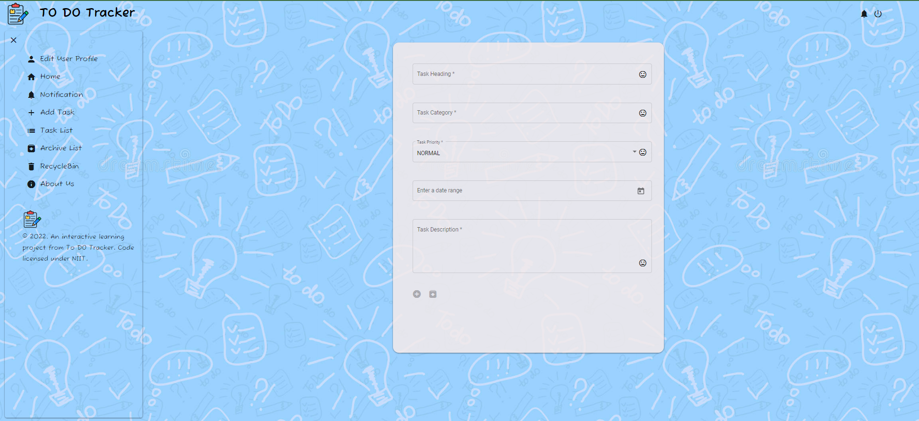
ADD TASK
WE CAN ADD OUR TASK , AFTER LOG IN .
TO ADD TASK , WE HAVE CLICK ON THE ICON ON THE TOP LEFT .
WE WILL GET A LIST OF OPTIONS , IN THAT JUST CLICK ON ADD TASK OPTION .
WE WILL GET A FORM , IN WHICH WE HAVE TO FILL OUR TASK DETAILS .
AT THE BOTTOM THERE WILL BE TWO OPTIONS ADD OR ARCHIEVE, BY CLICKING ON THE OPTION’S WE CAN SELECT OUR TASK TYPE .

Slide 14
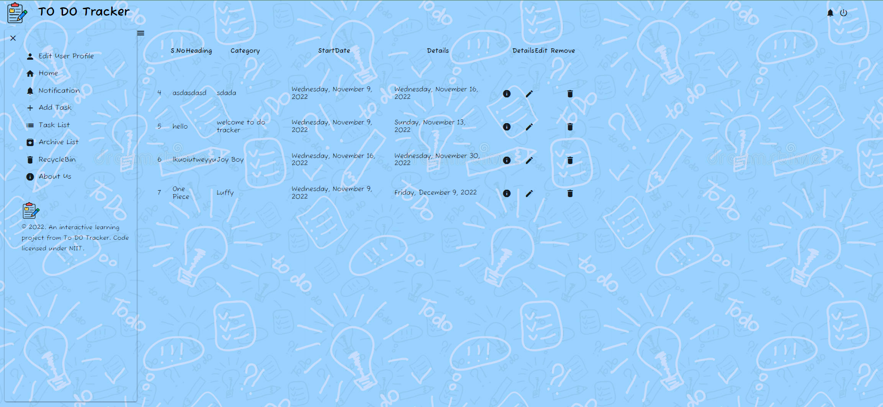
TASK LIST
THE TASK WHICH WE CREATE IN ADD TASK ARE SHOWN IN THE TASK LIST .
IN TASK LIST WE CAN EDIT THE TASK’S AND DELETE THE TASK’S WHICH WE HAVE CREATED.

Slide 15
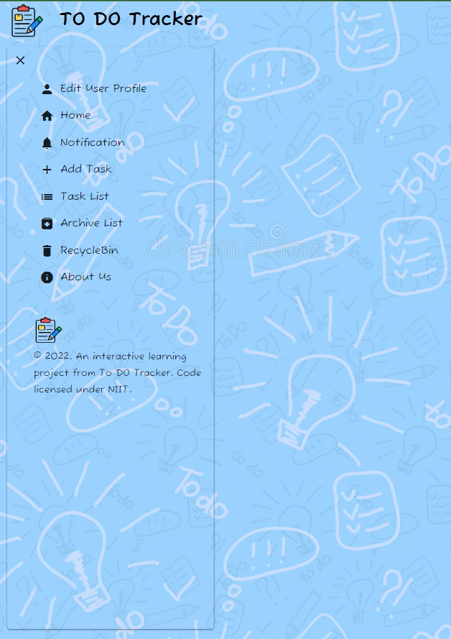
MENU
THERE ARE DIFFERENT OPTIONS LIKE :- HOME ,EDIT USER PROFILE ,NOTIFICATION ,ADD TASK ,TASK LIST ,ARCHIEVE LIST ,RECYCLE BIN AND ABOUT US.
HOME – HOME IS USED TO SHOW THE HOME PAGE.
NOTIFICATION – NOTIFICATION IS USED TO SHOW ALL THE TASK ACCORDING TO THEIR TASK COMPLETION .
ARCHIEVE LIST – ARCHIEVE LIST IS TO SAVE THE TASK AS PER USER NEED FOR LATER USE .
RECYCLE BIN – RECYCLE BIN IS TO STORE THE TASK REMOVED FROM THE TASK LIST, AND IF USER WANTS TO DELETE IT PERMANENTLY ,THEN USER CAN DELETE IT FROM HERE .
ABOUT US – ABOUT US IS TO SHOW YOU THE DETAILS AND LICENSE OF THE APPLICATION .

Slide 16
QUESTION AND ANSWER

Slide 17
THANK YOU

